Slide 1
Module # 9
Visualization and R Dr. Friedman

Slide 2
Graphics in R
When it comes to producing graphics in R, there are basically three options:
A. Base graphics
B. Lattice
C. ggplot2

Slide 3
A. Base Graphics
Wickham (2013) points out in his book on his R graphics package, the R base graphics system has a pen on paper design. The basic way it works is you set up the plotting area, and then you add elements to it. Once you've added an element to a plot, it cannot be removed, so it's good idea to keep a little plotting script going so you can re-plot your tweaks more easily.

Slide 4
Plotting Basics
The most basic command you can use to produce a plot is plot(). The first two arguments to plot() are taken to be x and y coordinates. If you only provide one vector of values, this is used as the y-coordinate, and it is plotted against the index values of the vector.
Plot Types
There are 9 basic ways for R to plot a set of points. To use one of these, define the type argument one of these ways:
p: points (this is the default)
l: a line
b: "both", points connected by line segments
c: just the connecting segments of "b"
o: "overplotted", points and lines overplotted
h: a histogram
s: stair
S: alternative stairs
n: none

Slide 5
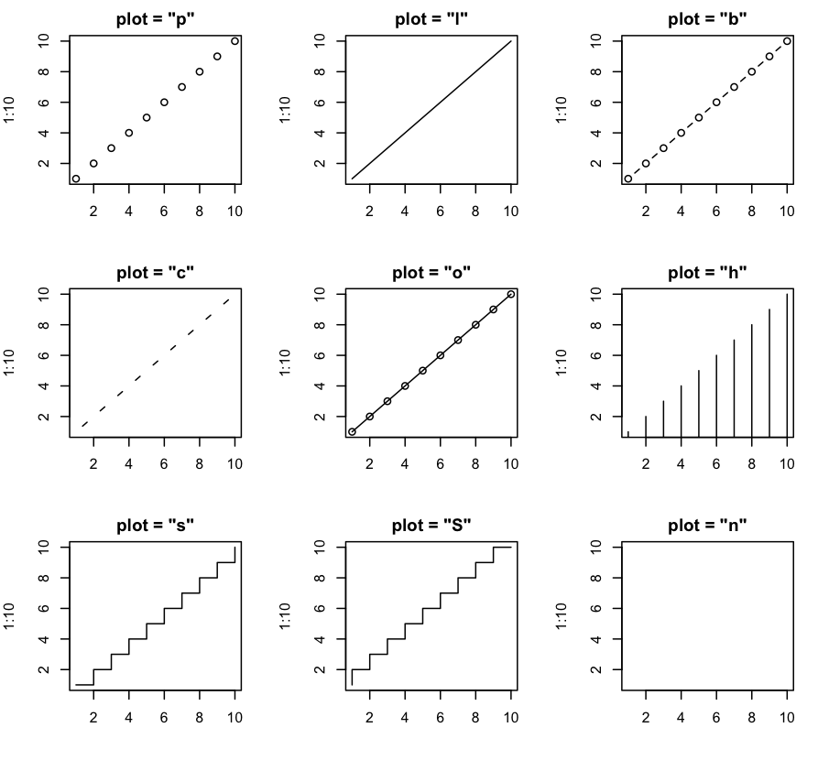

Slide 6
Points Types
There are 25 different plotting points that can be used by defining the argument pch (which I believe stands for "point character"). Points 21 thru 25 are multi-color points. Define the fill color for these with bg (which stands for "background").

Slide 7
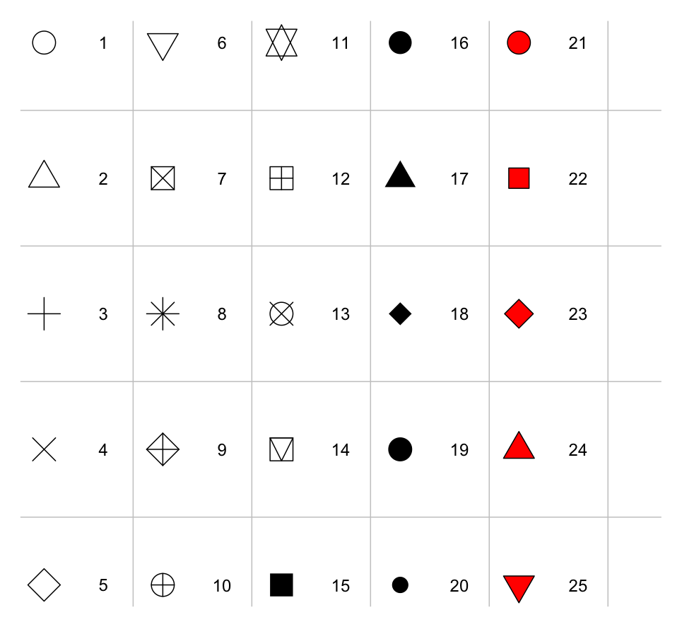

Slide 8
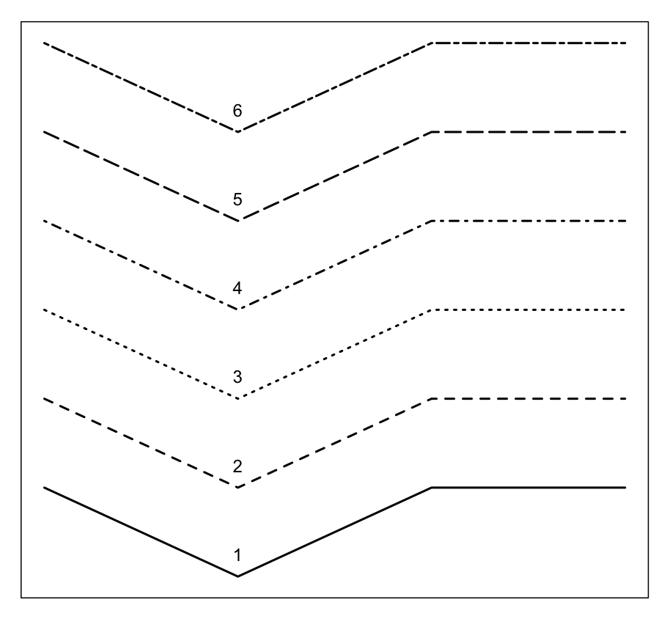
Line Types
There are 6 line types you can use by defining lty with 1 thru 6.

Slide 9
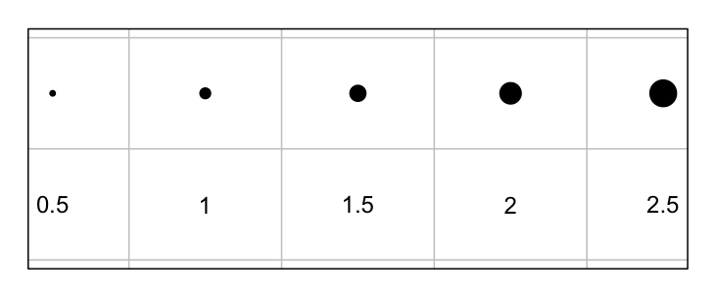
Weights and Sizes
To control the size of plotted points, give the argument cex (for character expansion) a value x, which will multiply the size of the character x times.

Slide 10
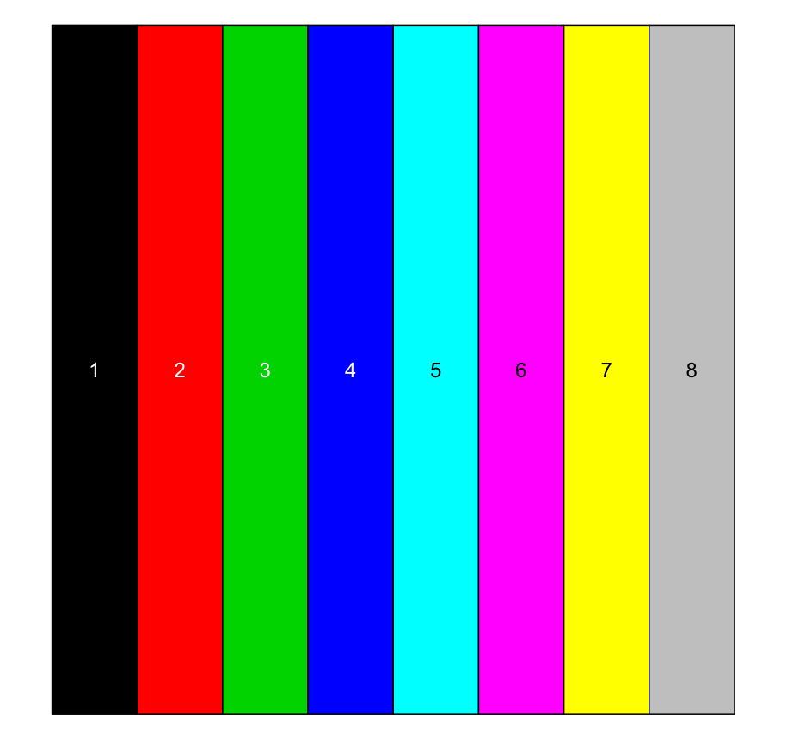
Colors
R has 8 default system colors, which can be assigned to a point or line by passing a numeric value of 1:8 to col
However, R has 657 named colors you can call upon by passing the name of the color to col. To see all the names, type colors() >colors()

Slide 11
Color palettes
There are particular color palettes that you could select colors from as well:
rainbow()
heat.colors()
terrain.colors()
topo.colors()
cm.colors()
grey()

Slide 12
More
If you give any of these functions a number, n, it will return that number of colors from the palette as a vector. There are also some other arguments you can pass to them as well, such as alpha, which controls transparency. They all share the same help page, so inspect that for more details.
The grey() palette is different, however. It takes a vector of values between 0 and 1 instead. 0 returns black, 1 returns white, and values in between return the appropriate percent grey.

Slide 13
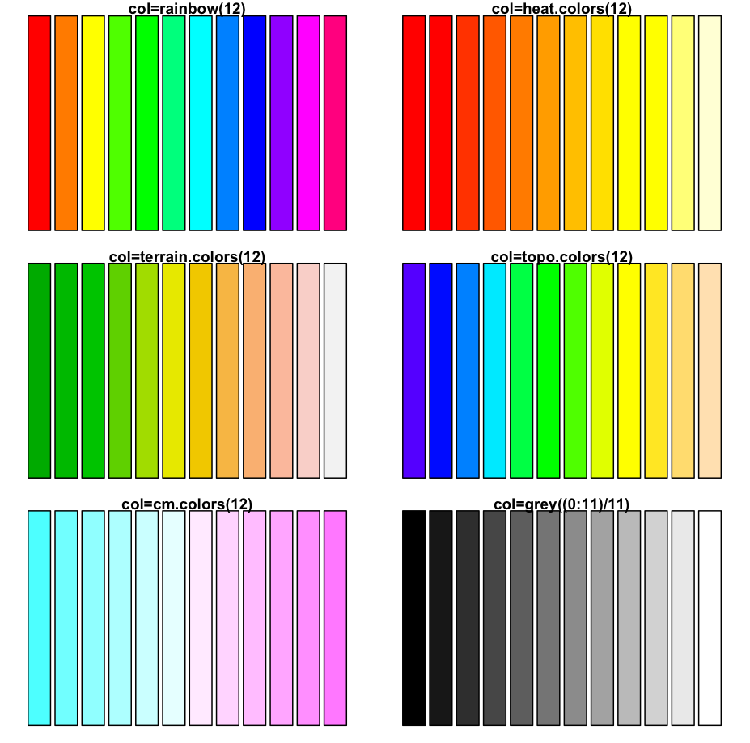

Slide 14
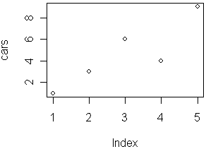
Building up Plots
>cars <- c(1, 3, 6, 4, 9) >plot(cars)
>plot(cars, type="o", col="blue") >title(main="Autos", col.main="red", font.main=4)

Slide 15
So, it this good enough?
The answer is No.
The disadvantages include
Awkward workflow for juxtaposition of many related plots. In base graphics, the user must deal with laying out the individual plots, working to keep axes consistent, etc. and this swiftly becomes extremely annoying.
No built-in support for encoding additional information, especially categorical, via color or line type etc. Again, the user bears sole responsibility for explicitly constructing and rendering graphical elements where symbol, color, size, etc. encode an additional variable. And you'll be adding the legend by hand too.
Good thing it's easy to customize because you'll be doing it all the time in base graphics.

Slide 16
Lattice package in R
Lattice graphics were developed by Deepayan Sarkar to implement ideas of Bill Cleveland in his 1993 book, Visualizing Data. Trellis graphics are used in S-Plus. Trellis graphs display a variable or the relationship between variables, conditioned on one or more other variables.
High-level lattice functions do not actually print or plot anything. They create an object of class "trellis", which can be printed or plotted.
Lattice graphics are very customizable, but par() settings have no effect.

Slide 17
Lattice – add-on package
The advantages of the lattice package include:
Multi-panel conditioning. Lattice put many scatterplots on one page, snuggled up next to each other with common (or sensibly linked) axis scales and limits.
Conveying additional information, especially via color or line type etc. The groups argument, especially coupled with auto.key = TRUE will handle most of your needs to, say, visually distinguish males and females and to create the associated key with minimal fuss.
Adding some obviously useful data summaries, such as a linear fit or a smoother, with minimal fuss. The type = argument is very powerful

Slide 18
Steps in using lattice package
Console in R
>install.packages(“lattice”) >library(lattice)
>xyplot(lat~long, data=quakes, pch=".") Decoding this command, the database is called quakes and incorporates a number of fields, including the latitude (lat) and longitude (long) of the individual quakes. The quakes are plotted at their locations using a small dot ("."). The locations are passed to xyplot using a formula (lat~long), with lat being the x coordinate and long the y coordinate. A scatterplot is generated (xyplot) and automatically printed.

Slide 19
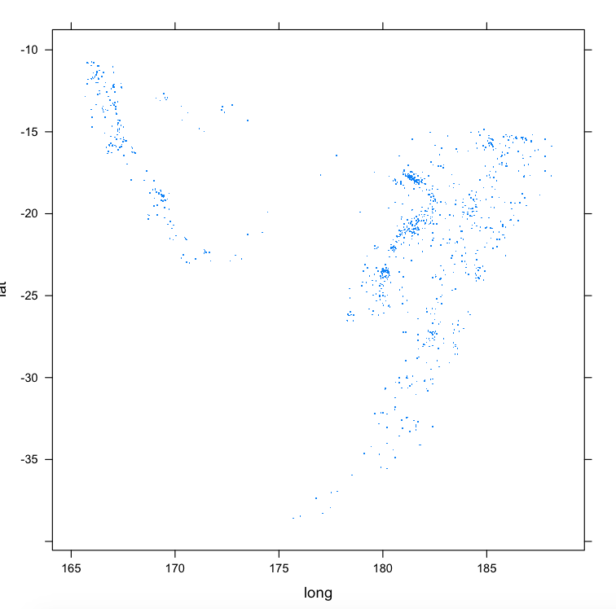

Slide 20
Note
You can also use the following commands to do the same thing:
>tplot<-xyplot(lat~long, data=quakes, pch=".")
>print(tplot)

Slide 21
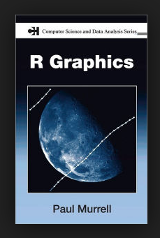
Why lattice?
Murrell gives three reasons for using lattice Graphics:
1. They usually look better.
2. They can be extended in powerful ways.
3. The resulting output can be annotated, edited, and saved.

Slide 22
The lattice plotting formula
The first argument to the lattice plotting functions is a formula. In the example, the formula is lat ~ long
If the plots take a single vector, the formula can be written as ~ long
~ long
with the y vector being names(x) if it exists or a single level factor otherwise. If the plot is three dimensional, the formula needs to be in the form:
z ~ x * y
The formula can include method calls like sqrt() or log() to transform individual dimensions. If the user wishes to plot two y columns (y1 and y2) against an x column, they need to write the formula as:
y1 + y2 ~ x
For two x columns (x1 and x2) against the y column, it's:
y ~ x1 + x2

Slide 23
Example of Histogram
>histogram( ~ height | voice.part, data = singer,
xlab = "Height (inches)", type = "density",
panel = function(x, ...) {
panel.histogram(x, ...)
panel.mathdensity(dmath = dnorm, col = "black",
args = list(mean=mean(x),sd=sd(x)))
} )

Slide 24
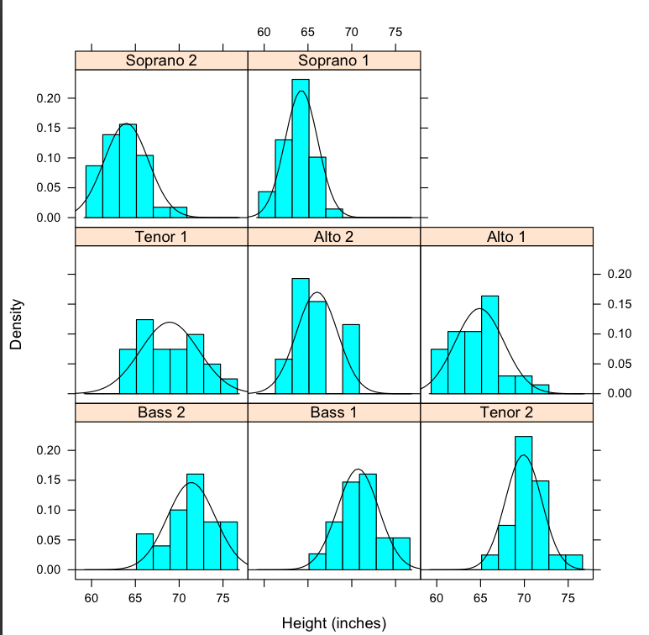
Result

Slide 25
Last example with lattice Graphics
It with wireframe – three-dimensional surface
>wireframe(volcano, shade = TRUE, aspect = c(61/87, 0.4),
light.source = c(10,0,10))

Slide 26
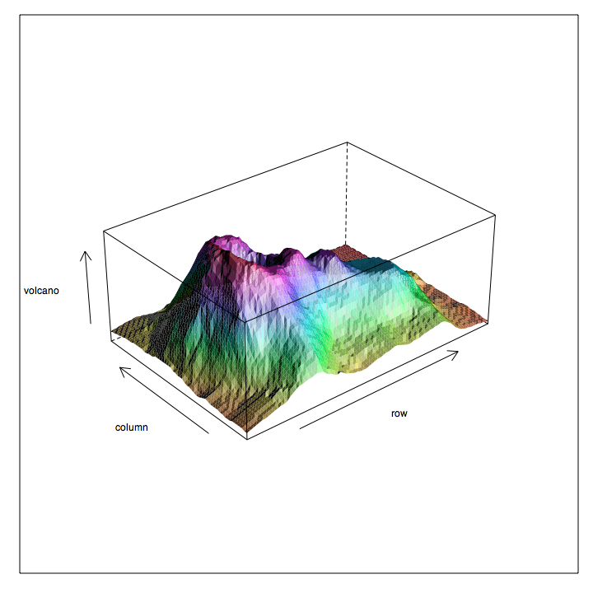
Result

Slide 27
ggplot2
The foundation of ggplot2 is based on Grammar of Graphics by Lead Wilkinson. The basic notion is that there is a grammar to the composition of graphical components in statistical graphics. Each component is added to the plot as a layer – something that never been done in statistical programming language.
The creator of the package is Hadley Wickham.
His personal website
ggplot2 website
His work in Rstudio
His last book publication, R package
His Github’s link

Slide 28
The structure of ggplot2
Aesthetics
Geometrics
Statistics
Scales
Other elements the package provides:
Coordinate systems
Faceting
Position adjustments
Data
Annotation
Fortify

Slide 29
Aesthetics
Plots convey information through various aspects of their aesthetics. Some aesthetics that plots use are:
x position
y position
size of elements
shape of elements
color of elements

Slide 30
Geometric
The elements in a plot are geometric shapes:
points
lines
line segments
bars
text

Slide 31
Scale
In the Grammar of Graphics, a scale controls the mapping from a variable in the data to an aesthetic.
In ggplot, we often use the color filling scale be determined automatically. But to use our custom color scheme, we need to take control of the mapping of the country factor into fill color in geom_point().

Slide 32
Some of these geometries have their own particular aesthetics.
points
point shape
point size
lines
line type
line weight
bars
y minimum
y maximum
fill color
outline color
text
label value

Slide 33
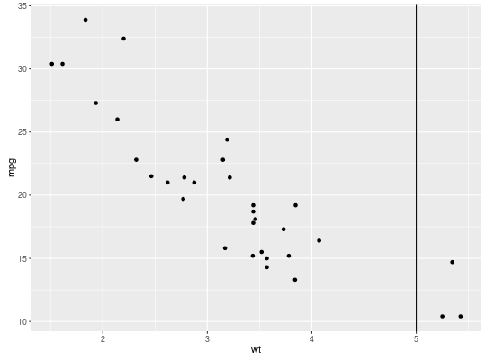
Example
> p <- ggplot(mtcars, aes(wt, mpg)) + geom_point()
> p + geom_vline(xintercept = 5)

Slide 34
Example
> p <- ggplot(mtcars, aes(wt, mpg)) + geom_point()
> p + geom_vline(xintercept = 5)

Slide 35
The code behind it
Mapping: Set of aesthetic mappings created by aes or aes_. If specified and inherit.aes = TRUE (the default), it is combined with the default mapping at the top level of the plot. You must supply mapping if there is no plot mapping. Data: The data to be displayed in this layer. There are three options: If NULL, the default, the data is inherited from the plot data as specified in the call to ggplot. A data.frame, or other object, will override the plot data. All objects will be fortified to produce a data frame. See fortify for which variables will be created. A function will be called with a single argument, the plot data. The return value must be a data.frame., and will be used as the layer data. Other arguments passed on to layer: These are often aesthetics, used to set an aesthetic to a fixed value, like color = "red" or size = 3. They may also be parameters to the paired geom/stat.na.rmIf FALSE (the default), removes missing values with a warning. If TRUE silently removes missing values.

Slide 36
The code behind it
show.legend Should this layer be included in the legends? NA, the default, includes if any aesthetics are mapped. FALSE never includes, and TRUE always includes.xintercept, yintercept, slope, interceptParameters that control the position of the line. If these are set, data, mapping and show.legend are overridden

Slide 37
Next example
>df <- data.frame(x = 1:10 , y = 1:10) f <- ggplot(df, aes(x = x, y = y)) f + geom_line(linetype = 2)
Behind the code:
# Line types should be specified with either an integer, a name, or with a string of
# an even number (up to eight) of hexidecimal digits which give the lengths in
# consecutive positions in the string.
# 0 = blank, 1 = solid, 2 = dashed, 3 = dotted, 4 = dotdash, 5 = longdash, 6 = twodash

Slide 38
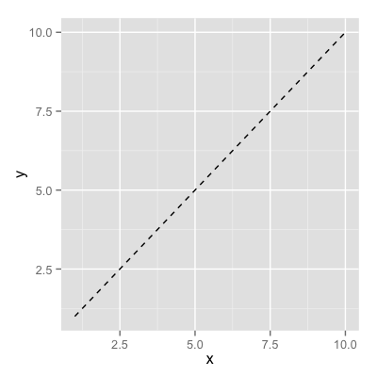
Result

Slide 39
So, what makes the qqplot2 so unique?
Layer by layer
All ggplot2 plots begin with the function ggplot().
ggplot() takes two primary arguments:
data
The data frame containing the data to be plotted
aes()
The aesthetic mappings to pass on to the plot elements
As you can see, the second argument, aes(), isn't a normal argument, but another function. Since we'll never use aes() as a separate function, it might be best to think of it as a special way to pass a list of arguments to the plot.

Slide 40
More examples of ggplot2
I highly recommend you to visit ggplot2.org

Slide 41
Next, ggplot and maps
I will illustrate very very simple map as illustrated in my book page 295.
I will use a package called “reshapes2” to create this map

Slide 42
ggplot2 and maps
>library(ggplot2) >crimes <- data.frame(state = tolower(rownames(USArrests)), USArres
>library(reshape2) # for melt
>crimesm <- melt(crimes, id = 1)
>if (require(maps)) {
states_map <- map_data("state")
ggplot(crimes, aes(map_id = state)) + geom_map(aes(fill = Murder), map = states_map) + expand_limits(x = states_map$long, y = states_map$lat)
last_plot() + coord_map()
ggplot(crimesm, aes(map_id = state)) + geom_map(aes(fill = value), map = states_map) + expand_limits(x = states_map$long, y = states_map$lat) + facet_wrap( ~ variable)
}

Slide 43
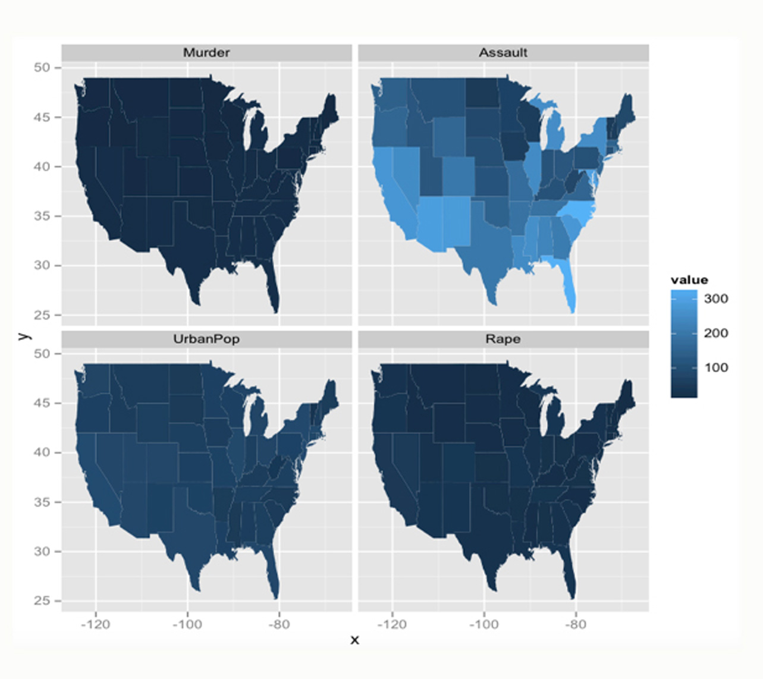

Slide 44
Summary
Visualization/graphics has been around for a long time but we still trying to search and understand its structure. The conversation of visualization of statistical language was discussed by many researchers. Wilkinson (2005) searches for grammatical rules for creating perceivable graphs. The R community and H. Wickham in particular, adopted his version to create the ggplot package, one of the most popular platform. In this module, we discussed how the ggplot allows us to create independent layers that we can add to our graph. I expect that in the future we will see more applications that will allow us to produce more advanced visualization using data as Photoshop Revolutionize the graphic design industry.
Overall, we look at three different types of visualization, basic, lattice and ggplot. Each carries its own structure and its own platform.

